Slide 1
HOME AUTOMATION USING TINKERCAD

Slide 2
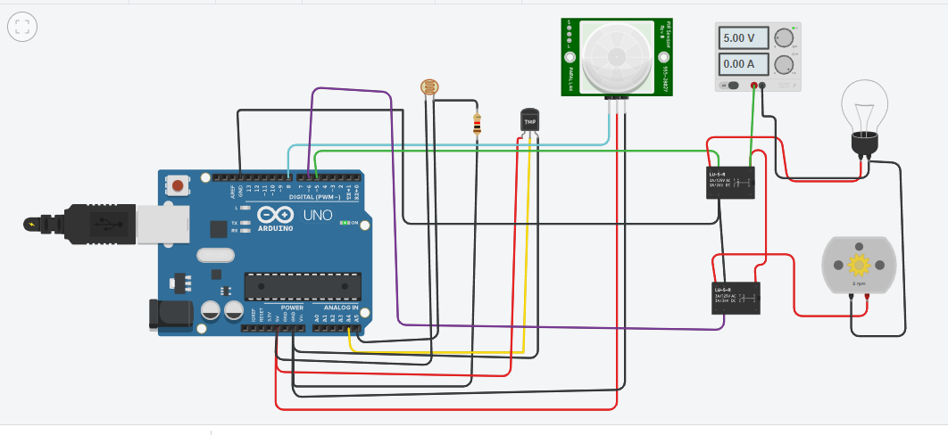
SMART HOME CIRCUIT

Slide 3
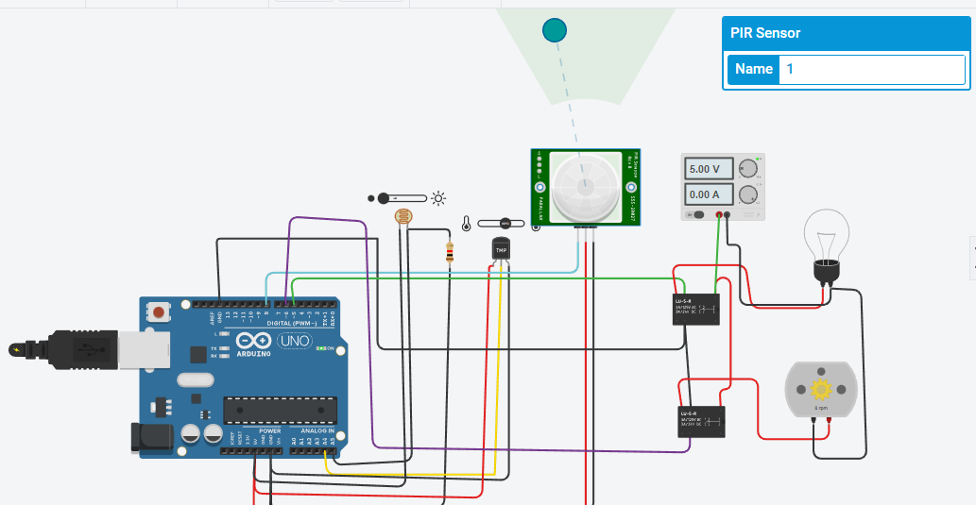
When temperature of sensor is mote than 30 degree Celsius then automatically will Turn ON

Slide 4
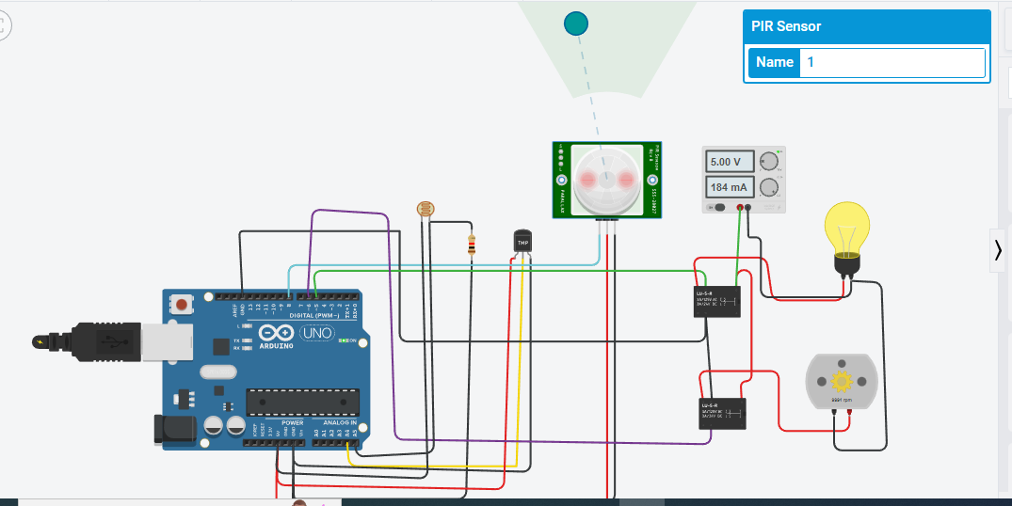
When LDR Detected Dark it Turn ON Light Bulb

Slide 5
SIMULATION CODE
float x,y,z,temp;
void setup()
{
pinMode(8, INPUT);
pinMode(5, OUTPUT);
pinMode(6, OUTPUT);
pinMode(A5, INPUT);
pinMode(A4, INPUT);
Serial.begin(9600);
}
void loop()
{

Slide 6
SIMULATION CODE
X=digitalRead(8);
Y=analogRead(A5);
z= analogRead(A4);
Serial.println(x);
Serial.println(y);
x= digitalRead(8);
y= analogRead(A5);
Serial.println(z);
temp = (double)z / 1024;
temp = temp * 5;
temp = temp - 0.5;
temp = temp * 100;

Slide 7
SIMULATION CODE
if ( (x>0) )
{
if ((y<550)&&(temp>30))
{
digitalWrite(5, HIGH);
digitalWrite(6, HIGH);
}
else if((y<550)&&(temp<30))
{
digitalWrite(5, HIGH);
digitalWrite(6, LOW);
}

Slide 8
SIMULATION CODE
else if((y>550)&&(temp>30))
{
digitalWrite(5, LOW);
digitalWrite(6, HIGH);
}
else if((y>550)&&(temp<30))
{
digitalWrite(5, LOW);
digitalWrite(6, LOW);
}
}
else
{
digitalWrite(5, LOW);
digitalWrite(6, LOW);
}
}

